Slide 1
Visualizing Social Interactions in Social Networks
Prof James P Curley
@jalapic
Psychology Department
Center for Integrative Animal Behavior
Columbia University

Slide 2
Introduction to Slide Notes:
This was a 45 minute talk on visualizing social network data. Some examples were taken from other tutorials, blogs and papers. Others were based on my own research.
The main aim of this talk was to get over some big picture ideas about network visualization rather than being a “how-to” exercise.
Nevertheless, the lecture was very interactive including live coding demos and many browser based examples – I include these links at the end
I clearly did not have time to engage with many possible examples. Lots of potential examples were missed out – some of these you can find in my
“Interactive and Dynamic Network Visualization” tutorial here: http://curleylab.psych.columbia.edu/netviz/

Slide 3
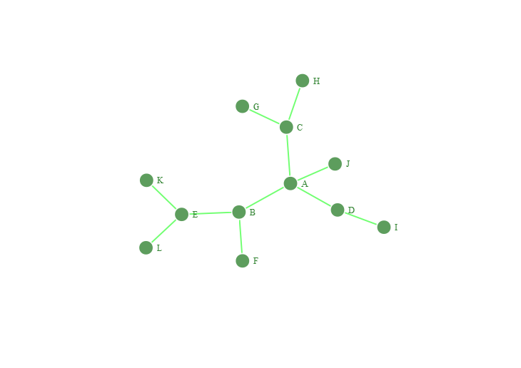
What is a Social Network ?

Slide 4
Data Structures
Edgelist
Sociomatrix / Adjacency Matrix
Network / Sociogram
A
A
A
A
B
B
C
C
D
E
E
B
C
D
J
E
F
G
H
I
K
L
 | A | B | C | D | E | F | G | H | I | J | K | L
A | . | 1 | 1 | 1 | 0 | 0 | 0 | 0 | 0 | 1 | 0 | 0
B | 1 | . | 0 | 0 | 1 | 1 | 0 | 0 | 0 | 0 | 0 | 0
C | 1 | 0 | . | 0 | 0 | 0 | 1 | 1 | 0 | 0 | 0 | 0
D | 1 | 0 | 0 | . | 0 | 0 | 0 | 0 | 1 | 0 | 0 | 0
E | 0 | 1 | 0 | 0 | . | 0 | 0 | 0 | 0 | 0 | 1 | 1
F | 0 | 1 | 0 | 0 | 0 | . | 0 | 0 | 0 | 0 | 0 | 0
G | 0 | 0 | 1 | 0 | 0 | 0 | . | 0 | 0 | 0 | 0 | 0
H | 0 | 0 | 1 | 0 | 0 | 0 | 0 | . | 0 | 0 | 0 | 0
I | 0 | 0 | 0 | 1 | 0 | 0 | 0 | 0 | . | 0 | 0 | 0
J | 1 | 0 | 0 | 0 | 0 | 0 | 0 | 0 | 0 | . | 0 | 0
K | 0 | 0 | 0 | 0 | 1 | 0 | 0 | 0 | 0 | 0 | . | 0
L | 0 | 0 | 0 | 0 | 1 | 0 | 0 | 0 | 0 | 0 | 0 | .

Slide 5
Social associations that are observed between individuals over time …
… how to best visualize these sociotemporal patterns ?

Slide 6
What to visualize ?
What questions are you interested in?
What do we want to communicate ?
Who is the audience ?
How do you want it to be viewed ?
What works best for your particular workflow?

Slide 7
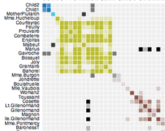
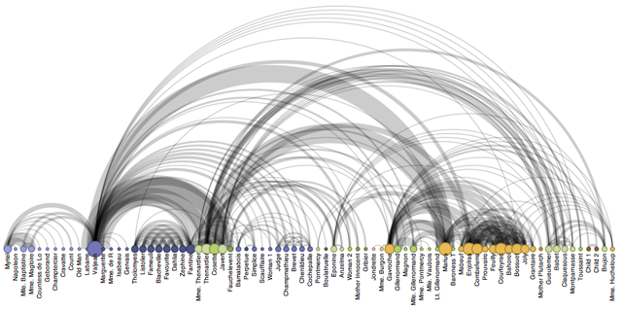
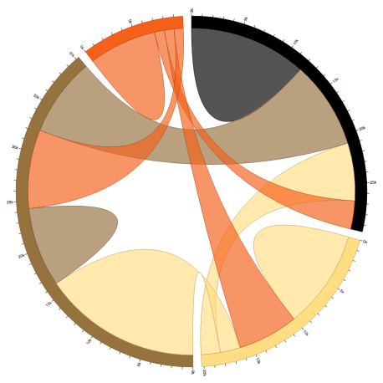
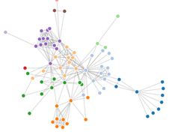
What to visualize ?
- Sociomatrices
Social Networks
Social Atom
Chord diagrams
Arc diagrams
Hierarchical trees
Timeline/Time-ordered networks
etc.

Slide 8







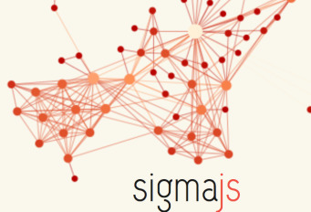







How to visualize ?

Slide 9
History of Network Visualization

Slide 10
Data from 1880–1881
German teacher Johannes Delitsch published in 1900 in ‘Zeitschrift für Kinderforschung’ (‘Journal of Child Study’).
| = Ingoing friendship relations (“angebotene Freunschaften”) - Child in column befriends child in row.
+ = Reciprocated friendships (“geschlossene Freundschaften”)

Slide 11
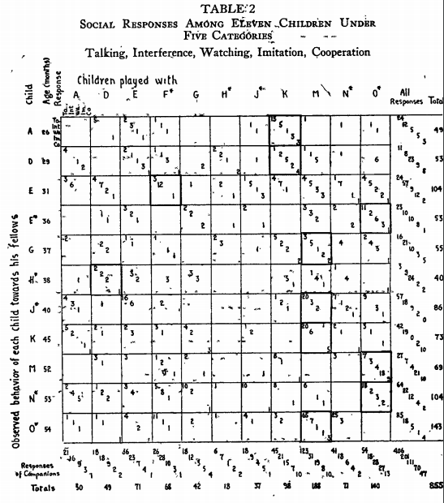
Helen Bott 1928
Observation of play activities in a nursery school.
talked to another
interfered with another
watched another
imitated another
cooperated with another

Slide 12

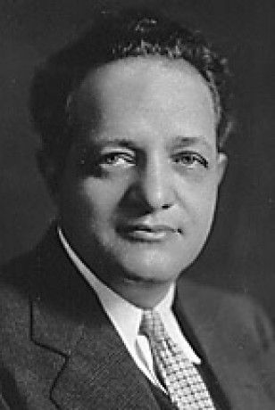
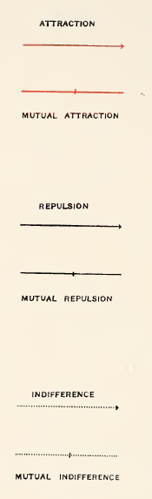
Jacob Levy Moreno
1934

Slide 13
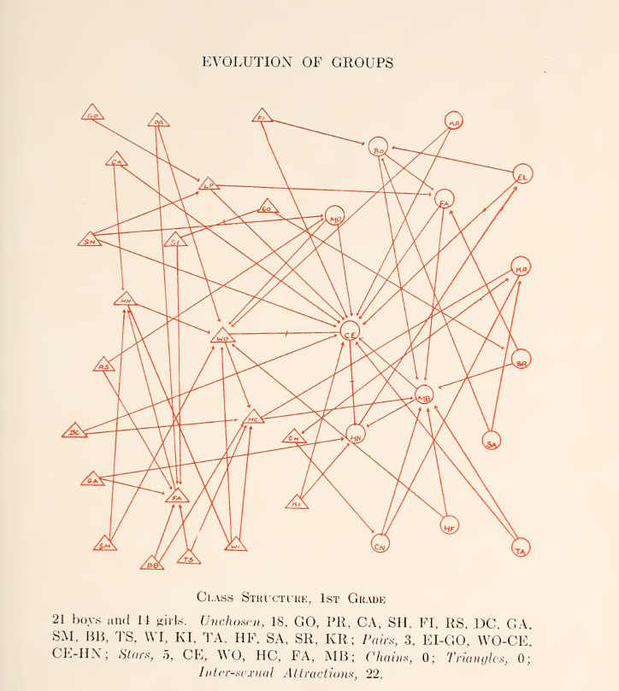
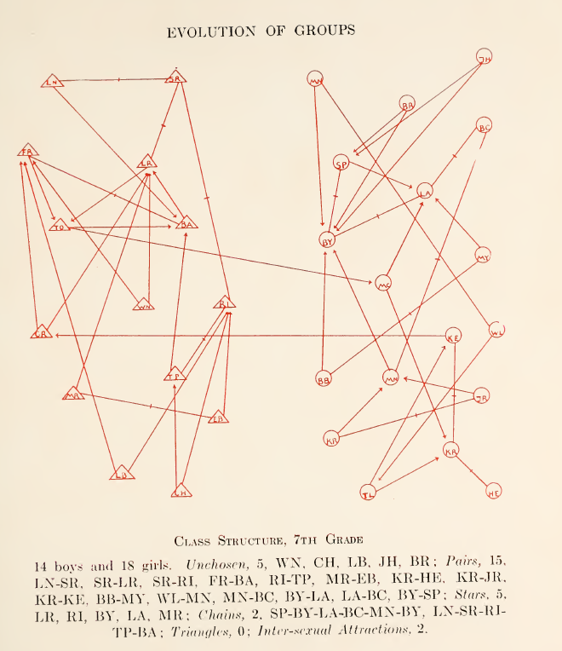
Notes:
It was required to choose among their classmates those whom each wants to have stay in the same classroom and to sit near him. At P.S. 181 in Brooklyn.

Slide 14
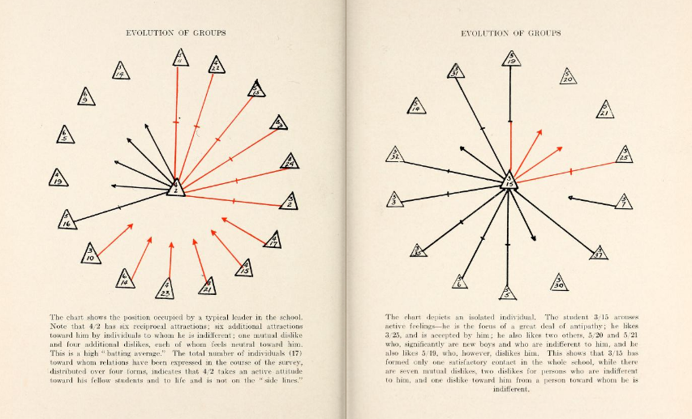
Social atom

Slide 15
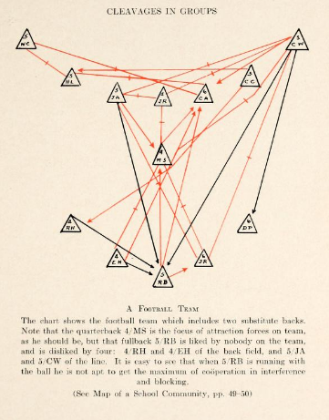

Slide 16
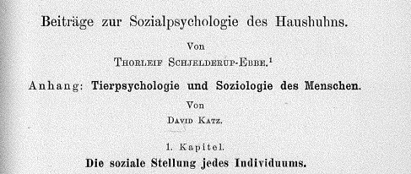
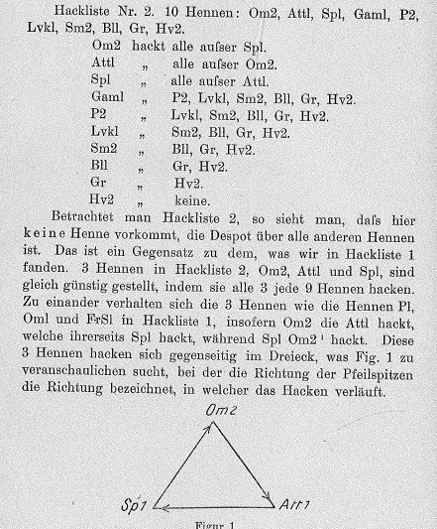
Thorleif Schjeldrup-Ebbe 1922
First demonstration of a social hierarchy in animals (chickens)
Demonstrated transitivity as feature of linear social hierarchies
Illustration of Network Intransitivity

Slide 17
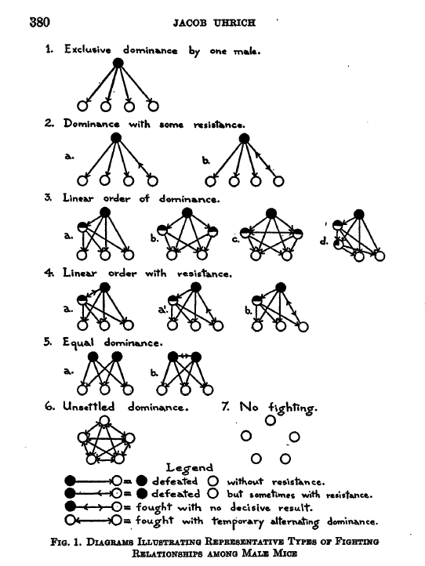
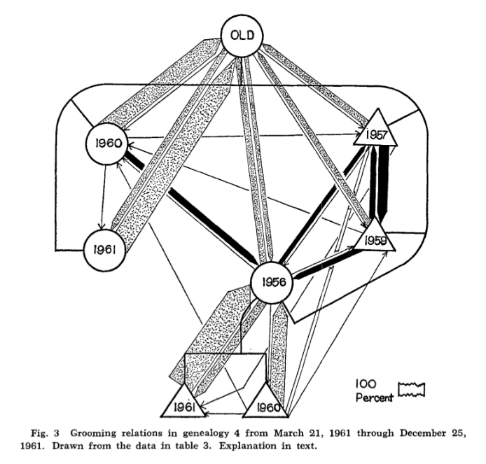
Jacob Uhrich 1937
Donald Sade 1965

Slide 18
Principles of Network Visualization

Slide 19
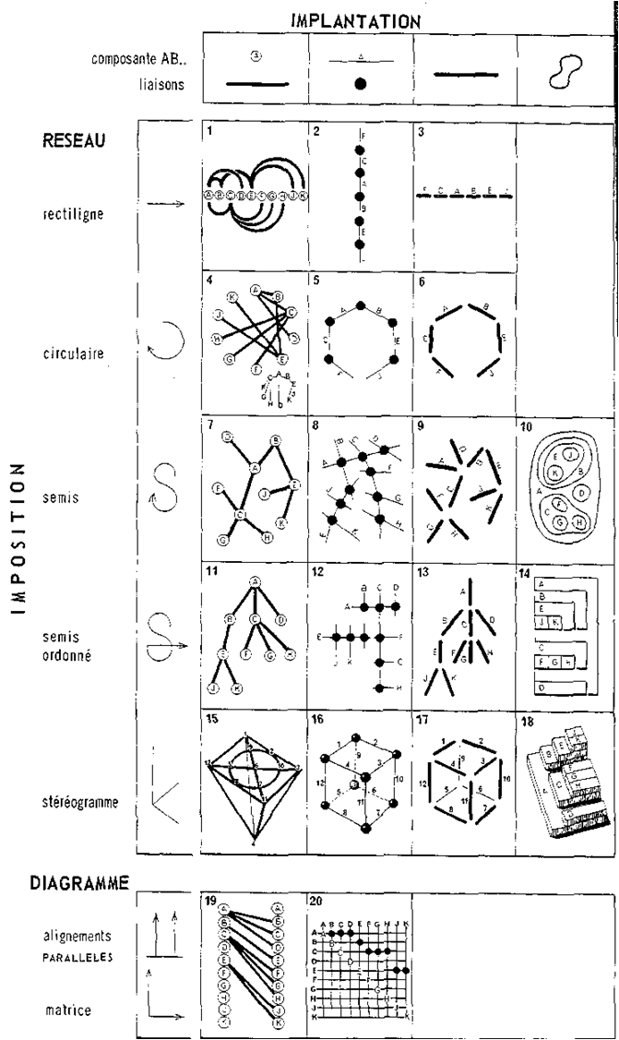
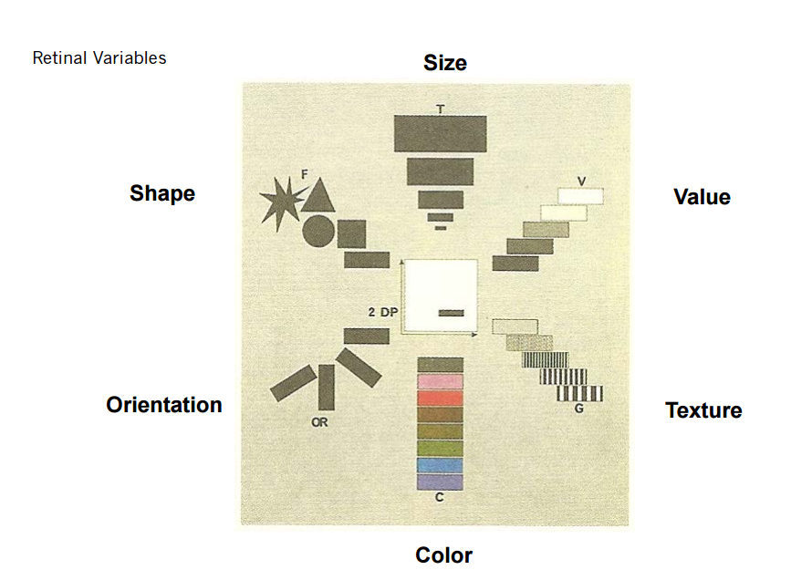
Jacques Bertin 1967
Semiology of Graphics: Diagrams, Networks, Maps

Slide 20
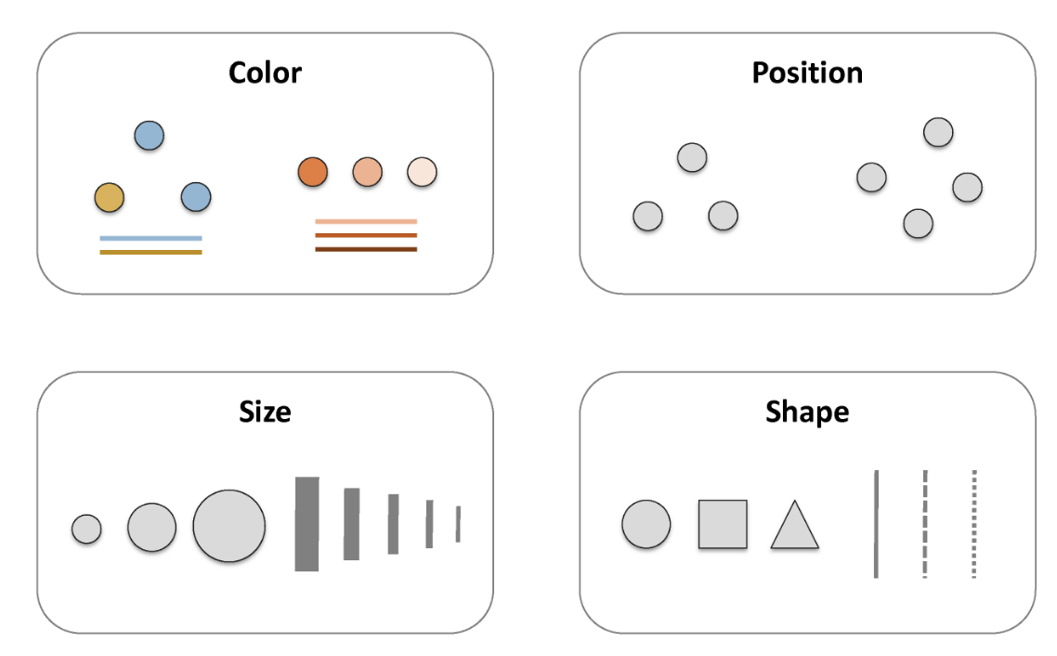
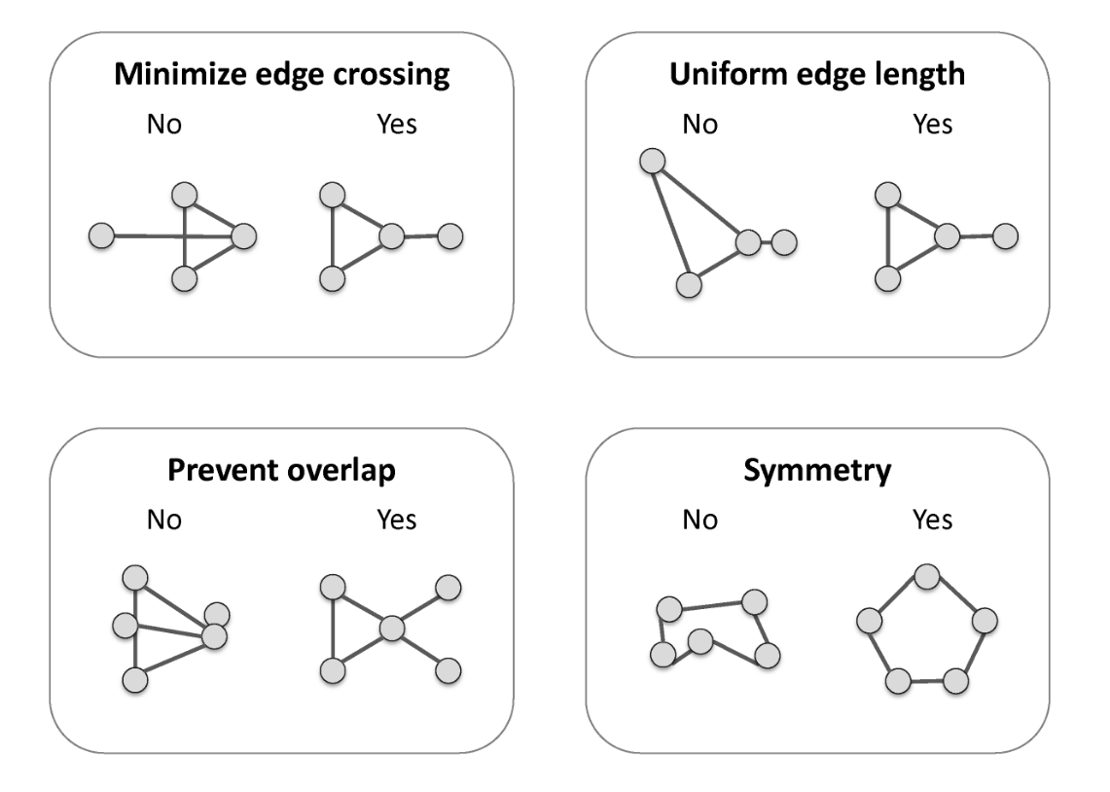
Basic Network Visualization Principles
Katya Ognyanova (Rutgers)

Slide 21
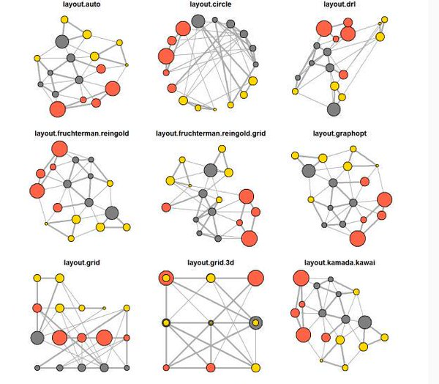
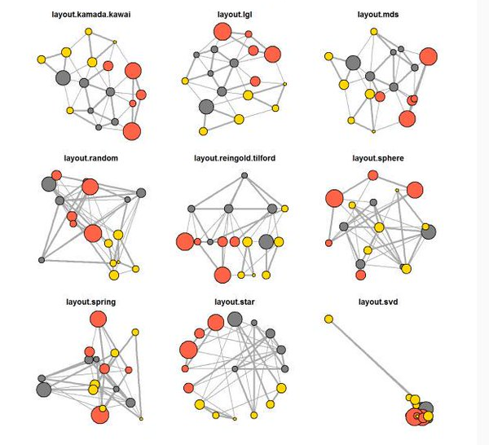
Basic Network Visualization Principles - Layouts
R – igraph package (Gabor Csardi)
Katya Ognyanova (Rutgers)

Slide 22
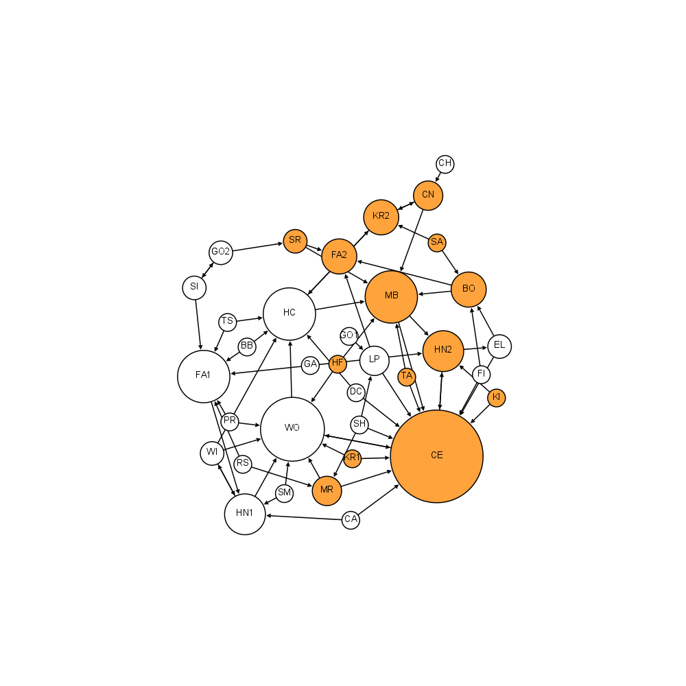
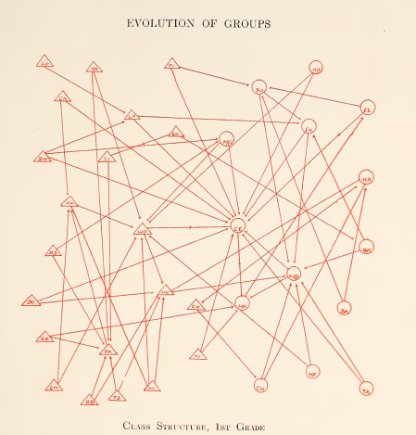
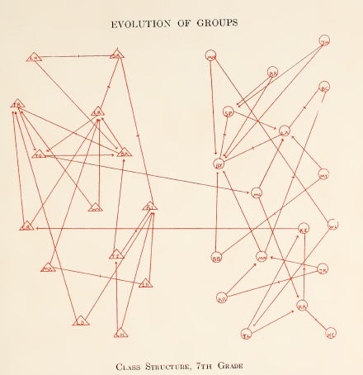
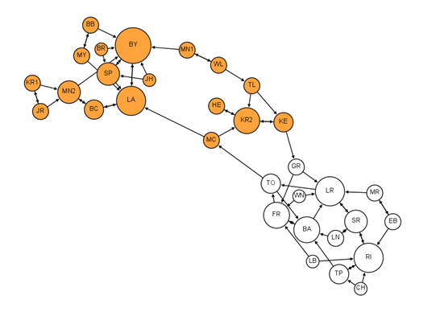
Identifying Network Structures & key nodes
1st Grade
Moreno’s original visualizations remade in Gephi by
Martin Grandjean
G1: 22 boy-girl edges
G7: 2 boy-girl edges
Node size – degree
Node color – gender
orange – girls
white – boys
7th Grade

Slide 23
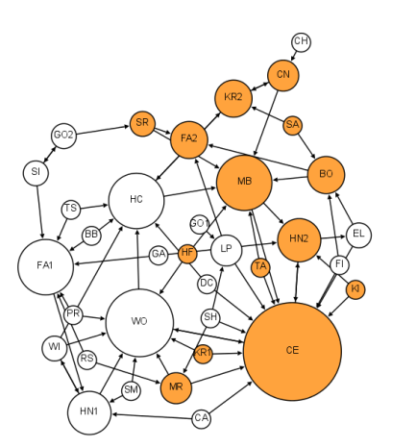
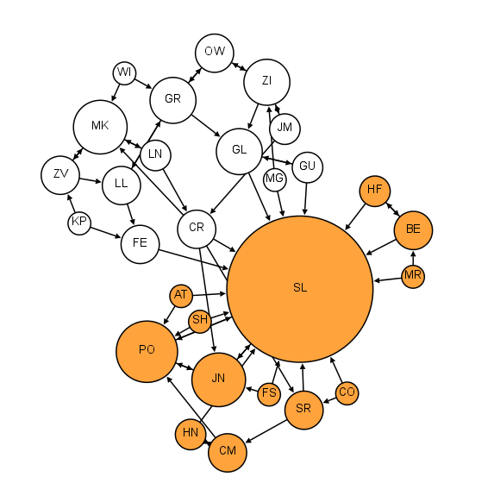
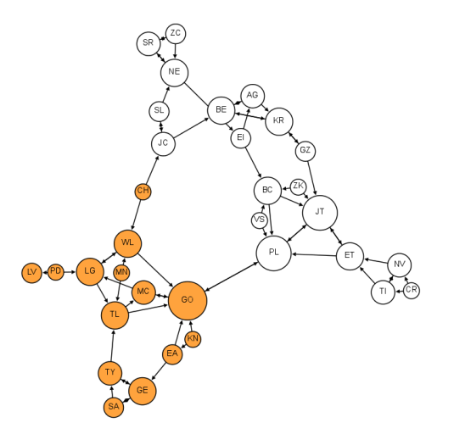
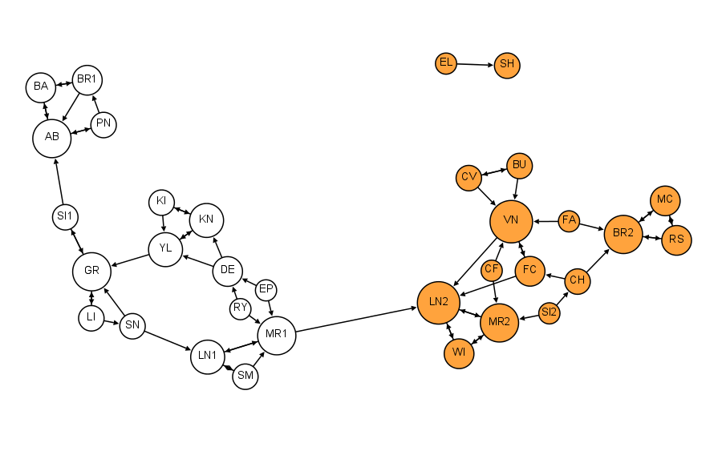
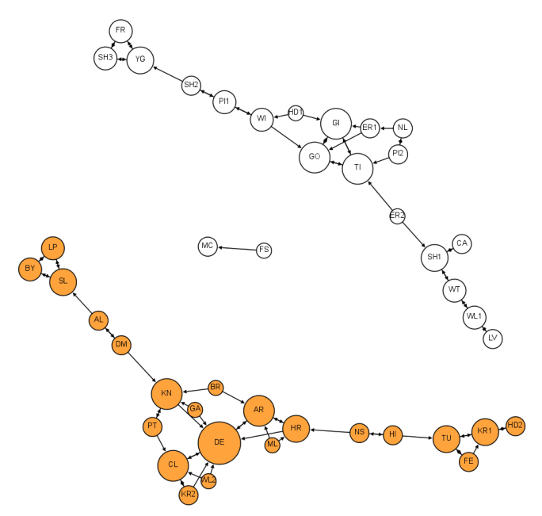
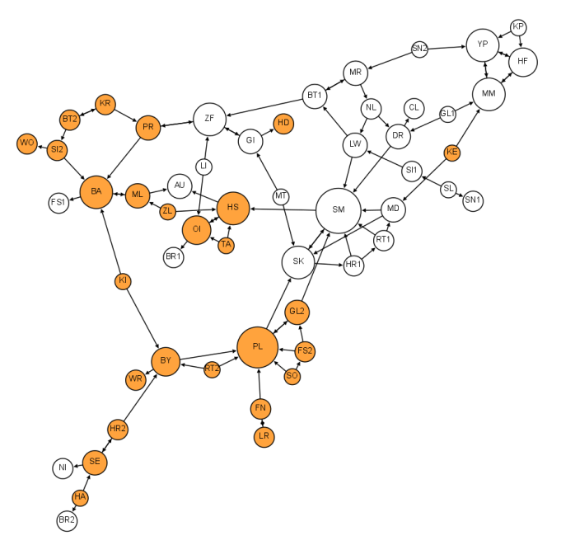
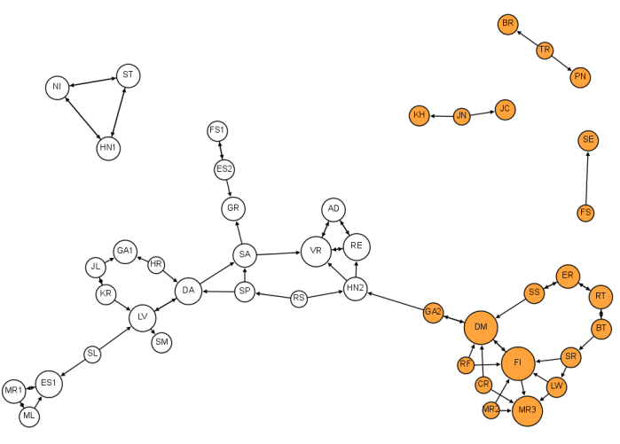
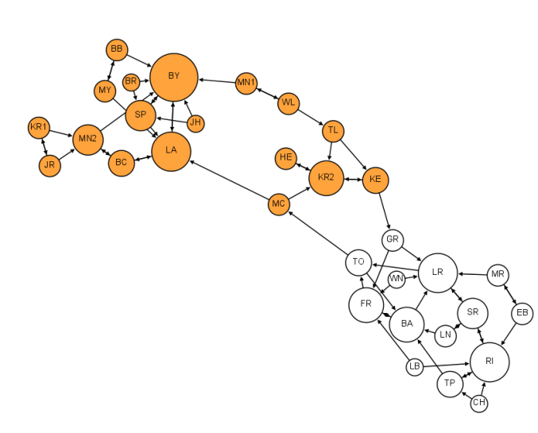
Changes in homophily, reciprocity & community structure across grades
Moreno’s original visualizations remade in Gephi by
Martin Grandjean
G1
G2
G3
G4
G5
G6
G7
G8

Slide 24
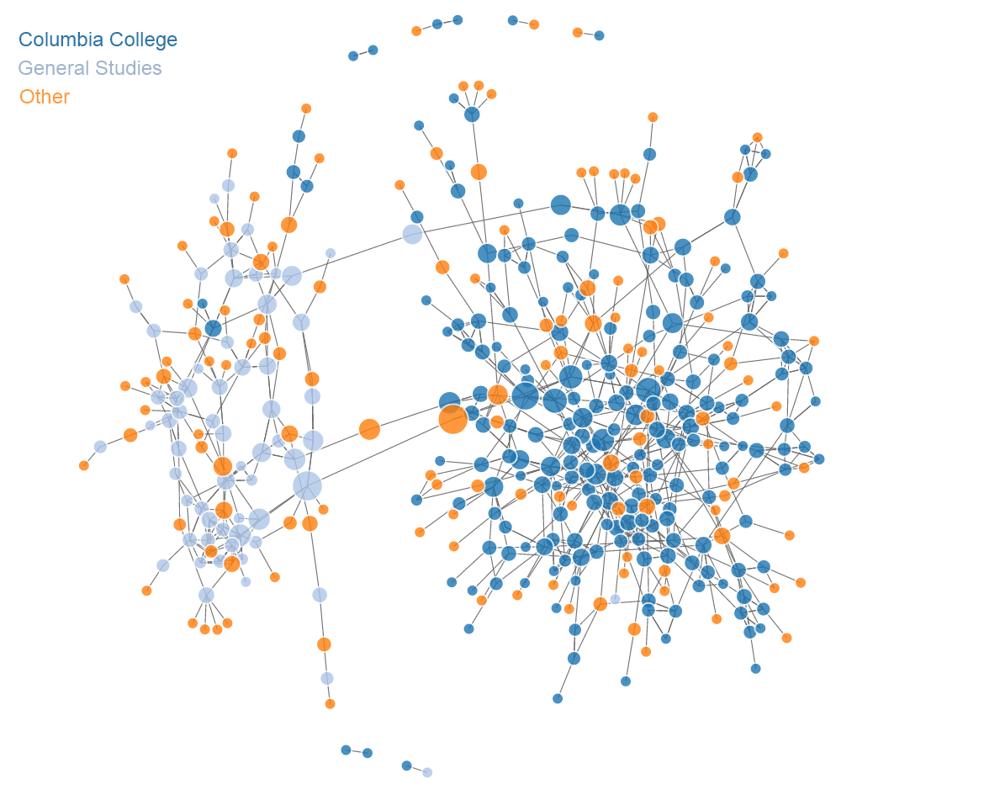
Friendship Network in Columbia Intro Bio Classes
(with Kaytee Turetsky)
Made with D3.js & networkD3 R package

Slide 25
Extensions to Network Visualization
Limits to what can be inferred immediately from a static network visualization
Interactivity – users gain more insight through interactivity & can explore data for themselves
Broswer based :
e.g.
Filtering data
- Mouseover /onClick events
Linked matrices/networks

Slide 26
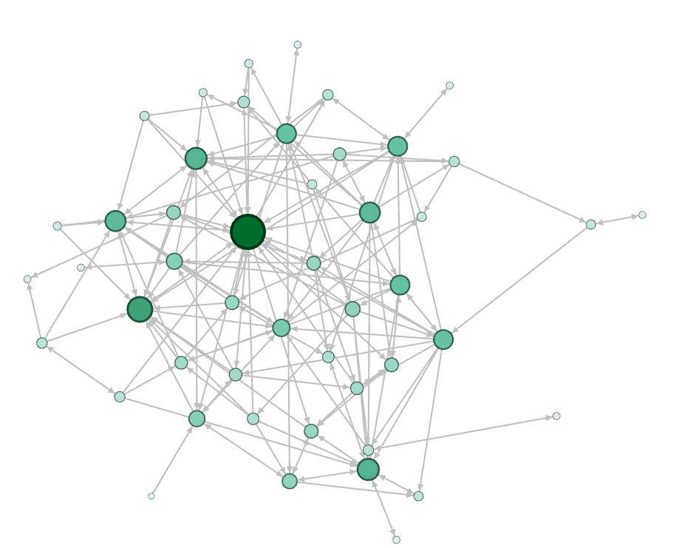
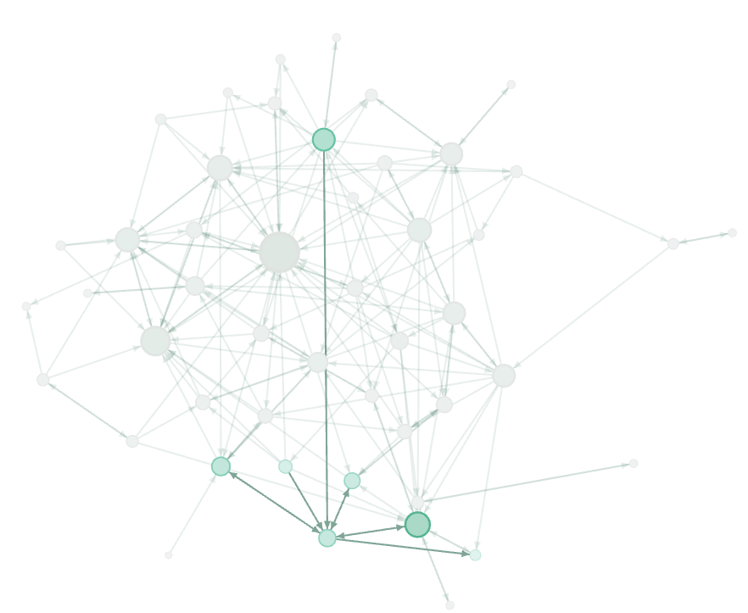
Filtering Information - less is more
Friendship connections in
German school 1880
e.g. identify neighbors in Gephi
Schmidt has 3 reciprocated friendships, 1 outgoing only & 2 incoming only

Slide 27
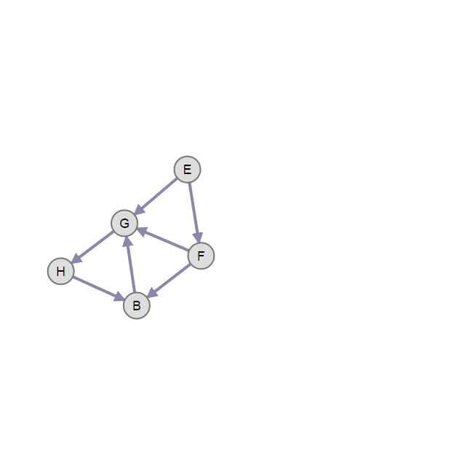
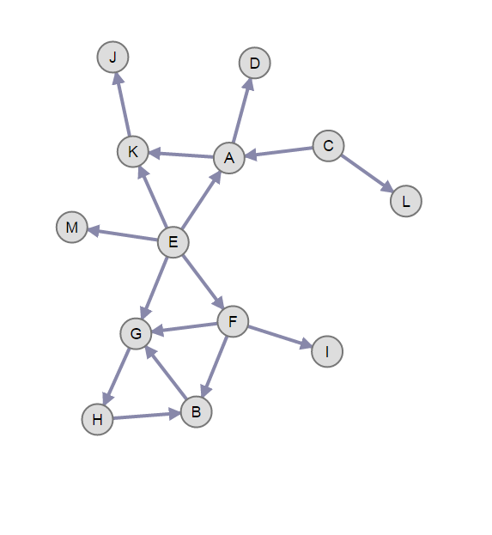
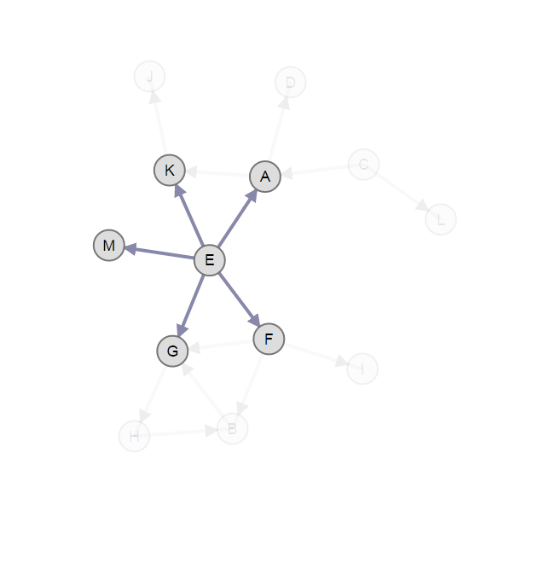
Filtering Information - less is more
e.g. identify direct neighbors in D3.js
e.g. identify triads in D3.js
blockbuilder.org/jalapic

Slide 28
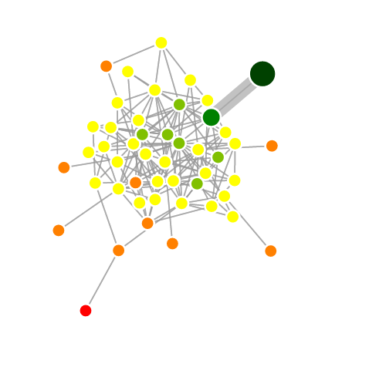
Interactivity
e.g. find geodesic distances in D3.js
Who is 1, 2, 3, 4 geodesic distance from Flach ?
blockbuilder.org/jalapic

Slide 29
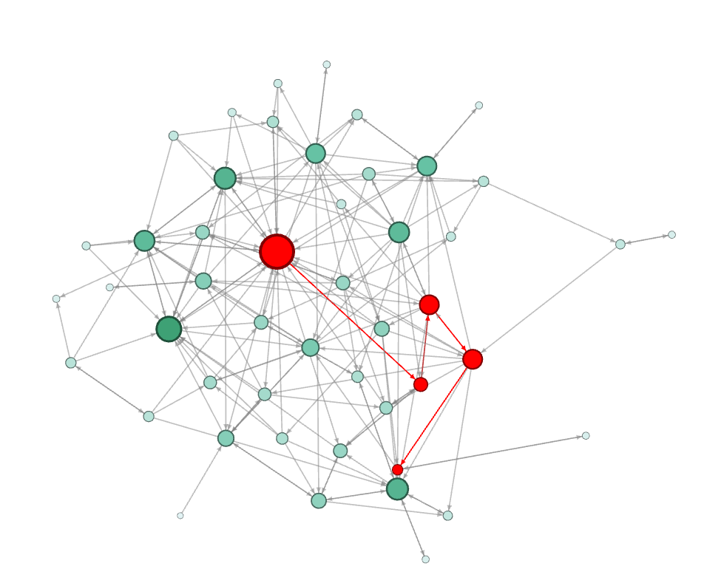
Interactivity
Friendship connections in
German school 1880
e.g. identify shortest paths
Example – Gephi
Pfeil → Fritzsche → Fährmann → Stolze → Lasch
Pfeil & Lasch have a geodesic distance of 4

Slide 30
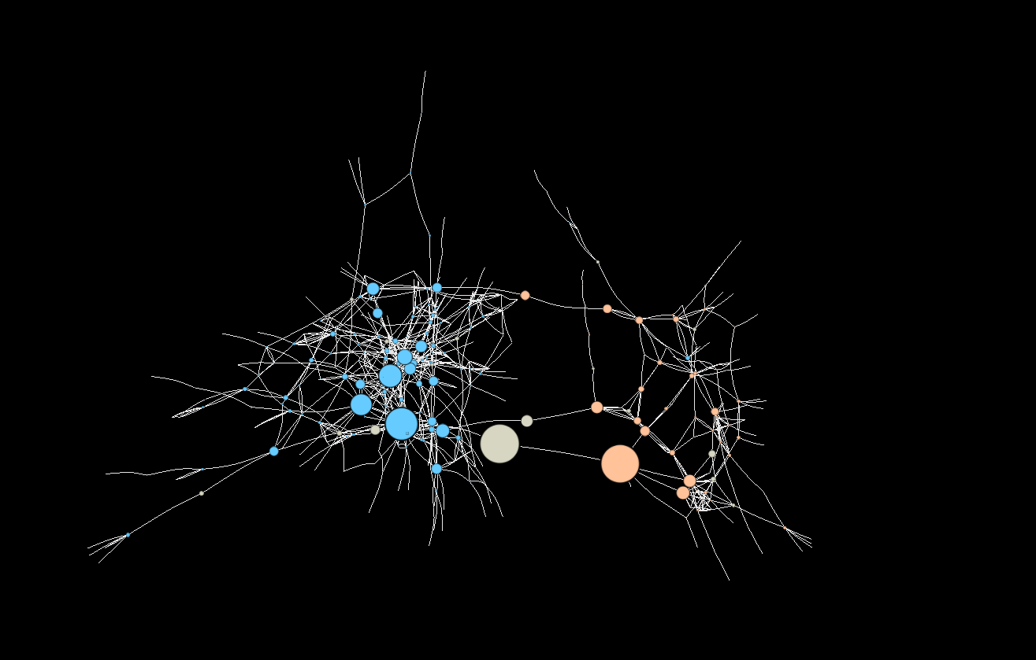
Filtering Information - less is more
e.g. Only showing nodes of high betweenness
Made using
rthreejs

Slide 31
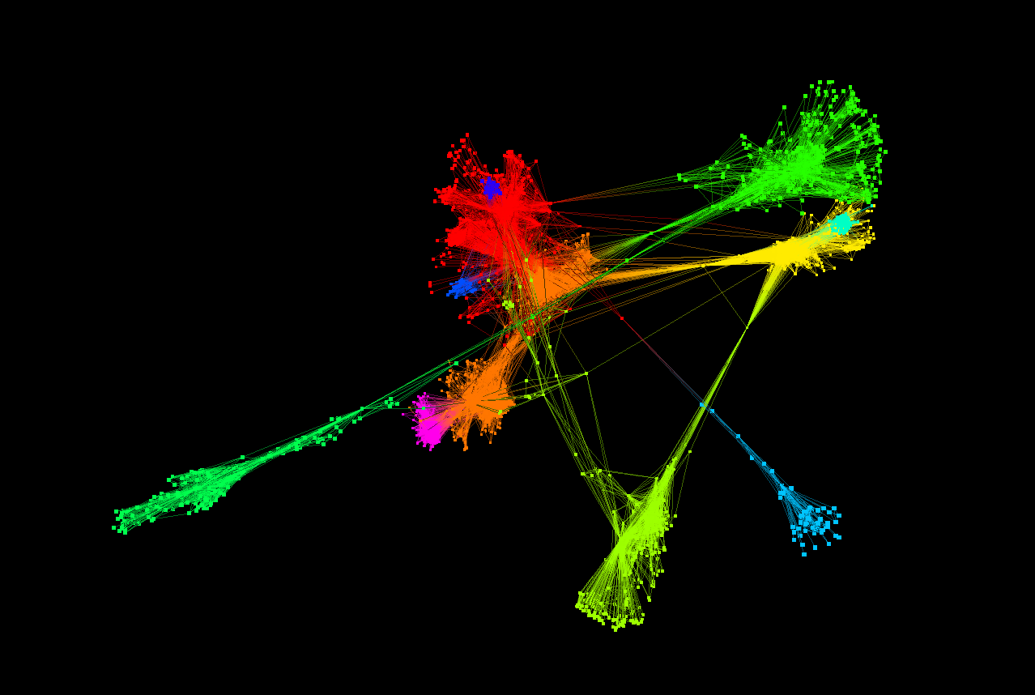
3D Network Representations
Community structure
among friends in
Facebook data
(Stanford SNAP repository)
Using rthreejs
Bryan Lewis

Slide 32
Is a network really the right visualization ?

Slide 33
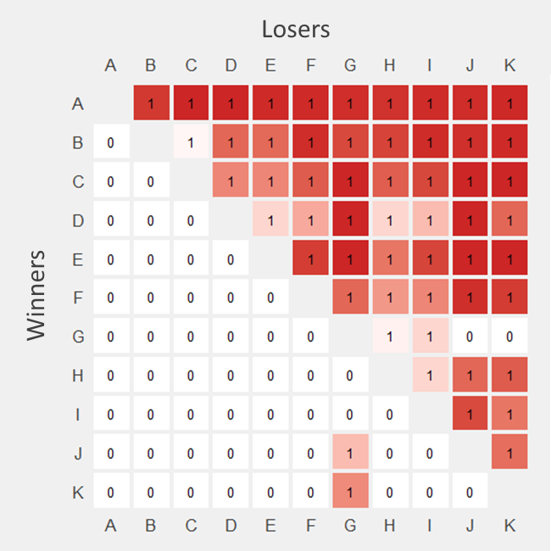
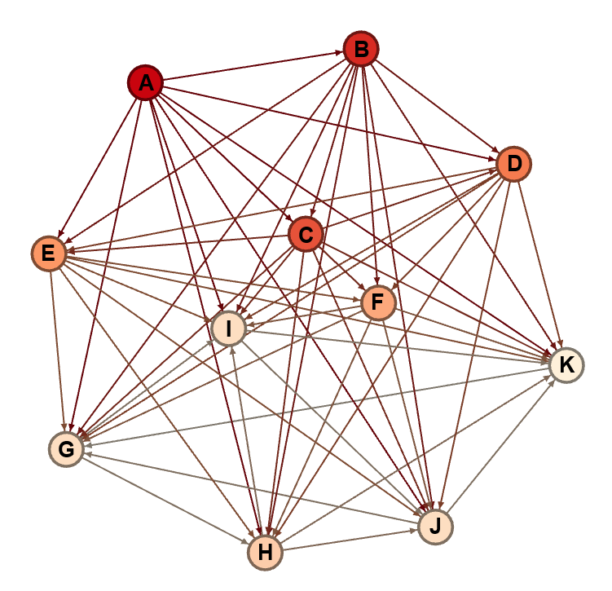
Social Network Analysis of Social Hierarchies
Comparing many networks by
visual inspection may not be
that easy or intuitive
Adjacency Matrix
Network Graph

Slide 34
Mouse Social hierarchies are highly linear
R - ggplot2
Williamson et al. Anim Behav 2016.

Slide 35
Mice have unique ranks and show high directional consistency of behavior
R - ggplot2
Williamson et al. Anim Behav 2016.

Slide 36
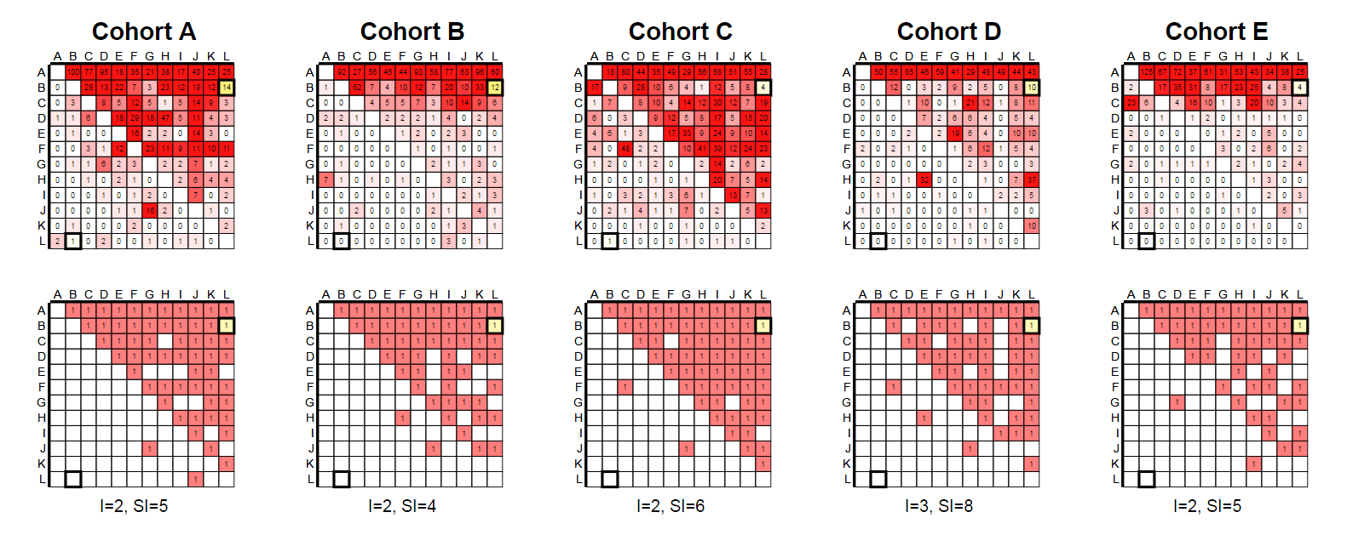
D3.js – linked matrices.
http://curleylab.psych.columbia.edu/socdom1.html

Slide 37
How to encode TIME in Networks ?
TIME
Time-ordered network - visualize all observed data for network dynamics for every unit of time
Time-aggregated network - visualize networks within aggregated time windows.

Slide 38
How to encode TIME in Networks ?
TIME
SMALL MULTIPLES ANIMATION TIMELINES

Slide 39
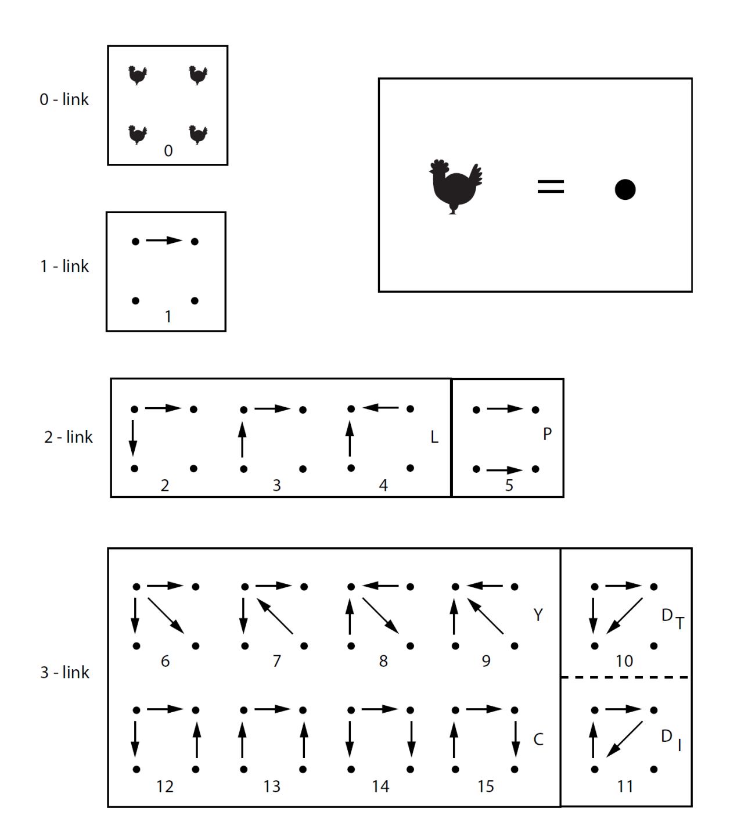
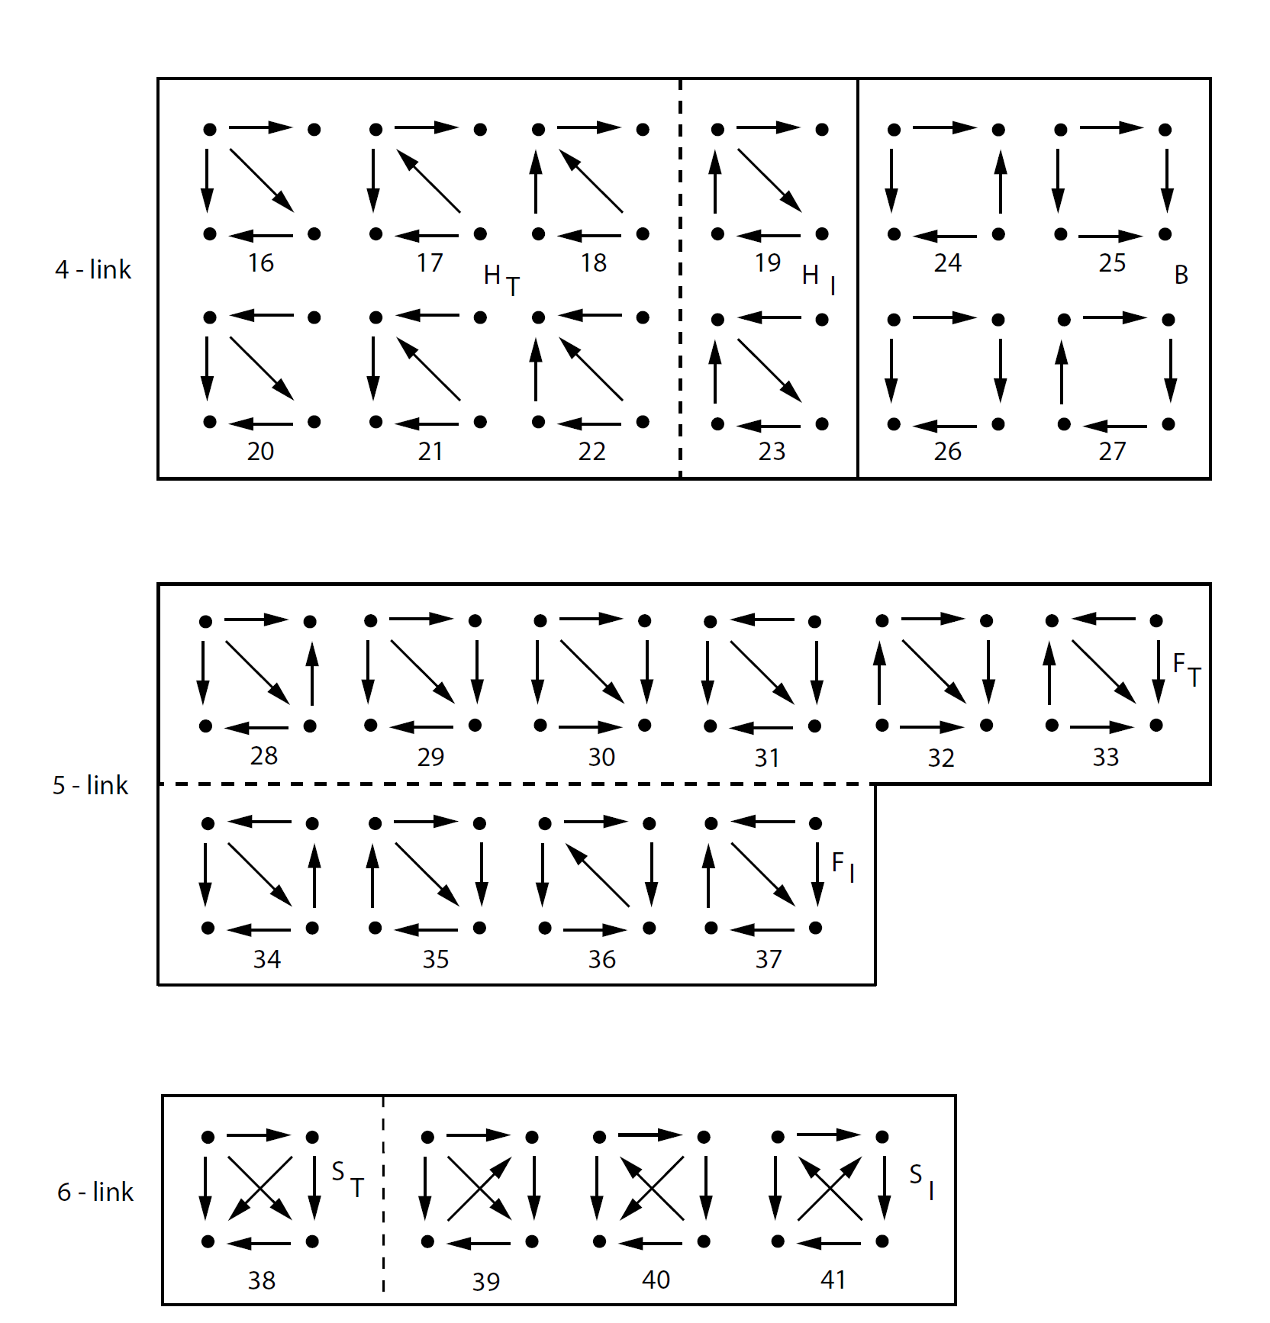
(Collaboration with Prof Ivan Chase – Stony Brook)
R package - hierformR

Slide 40


Small Multiples
Network Formation in African Cichlid Fish
1
7
Every interaction from initial formation through 24 hours
Proportion of time spent in transitive vs. intransitive states
Likelihood of transitioning between transitivity/intransitivity
13
19
25
Intransitive
Transitive
41 unique network types
(Collaboration with Prof Ivan Chase – Stony Brook)
R package - hierformR

Slide 41
Small Multiples
The Rise of Partisanship and Super-Cooperators in the U.S. House of Representatives
Andris et al. PlosOne 2015

Slide 42
Small Multiples
Progression of flu contagion in the friendship network over time.
Edges = friendship nomination
White = uninfected individuals/friends
Red = Infected individuals
Yellow = friends of infected individuals
Node size = proportional to the number of friends infected.
Christakis & Fowler 2010 PlosOne

Slide 43

Made with SONIA
Animated
Christakis & Fowler 2010 PlosOne

Slide 44

Animated
D3.js
e.g. See this example

Slide 45

Animated Networks using R
SEE my ONLINE TUTORIAL …
http://curleylab.psych.columbia.edu/netviz/netviz5.html
SEE recent animations in rthreejs - http://bwlewis.github.io/rthreejs/animation/animation.html

Slide 46

Timelines
(Ivan Chase)

Slide 47

Timelines
Curley 2016 – “musicnotationR” R package

Slide 48

Timelines
Shiny App: https://jalapic.shinyapps.io/music/
Filter all aggressive interactions (incoming & outing) for animal Rank #3 - high directional consistency of behavior
Colors represent unique individuals
Curley 2016 – “musicnotationR” R package

Slide 49

Timelines
Dan Rubenstein- Princeton
PlosOne 2015
Community membership over time in zebras vs onagers

Slide 50
Conclusions
Lots of tools exist to visualize networks
It’s easy to make really attractive network visualizations
It’s also easy to make really bad network visualizations
What question do you want to explore or communicate to an audience?
What’s the most effect way of achieving that?
Learn the programming language / software that will facilitate this !

Slide 51
Links to examples in talk
Katya Ognyanova tutorials - http://kateto.net/
Martin Grandjean work - http://www.martingrandjean.ch/social-network-analysis-visualization-morenos-sociograms-revisited/
My friendship visualization - http://curleylab.psych.columbia.edu/friendship.html
My friendship visualization 2 - http://curleylab.psych.columbia.edu/friends.html
Identifying neighbors in D3js - http://blockbuilder.org/jalapic/0020bebb012760de0d54
Identifying triads in D3js - http://blockbuilder.org/jalapic/aeb4b1085f800d31b4be
Identifying geodesic distance in D3js - http://blockbuilder.org/jalapic/0eba1241acdf67c62f5b87357864d662
rthreejs example by Bryan Lewis - http://jalapic.github.io/facebook
Linked Matrices in D3js - http://curleylab.psych.columbia.edu/socdom1.html
D3js animated network example - http://blockbuilder.org/jalapic/cf1454d62c7efa48d96ee4d803856dfa

